Slide 1
A Geocoding Locator of UT Dallas
Using
ESRI.ArcGIS.Geodatabase.ILocator
ESRI.ArcGIS.Location.IAddressGeocoding
ESRI.ArcGIS.Location.IReverseGeocoding
Language: VB.NET
By Caiyi Zhong
Apr. 27th, 2014

Slide 2
Address Locator
ToLeft / ToRight
FromLeft / FromRight
ArcMap
Desktop App.
Etc.
Street Name
15
Address Locator
Deploy
29
14
Street Type
Some St.
28
Another St.
Create
Internet
Other People
Etc.
Publish
Locator is created with
Reference Data
Locator could be
saved as files

Slide 3
Address Locator
Address Locator
= Locator Style + Reference Data + Field Mapping
Locator Style:
- US Address - Dual Ranges e.g. 12345 Coit Rd
- US Address - ZIP 5 Digit e.g. 75080
- General - City State Country e.g. Dallas, TX, USA
- …
Different style accepts different address formats.

Slide 4
ESRI vs. Custom Address Locators
ESRI provides some nationwide address locators and geocode services that you can use right away to geocode addresses in ArcGIS.
But, we still can collect data and create our own locators. Custom locators could be specified to meet our special needs.
We can restrict our analysis in a certain area, create the street data, and generate the locator for this area.

Slide 5
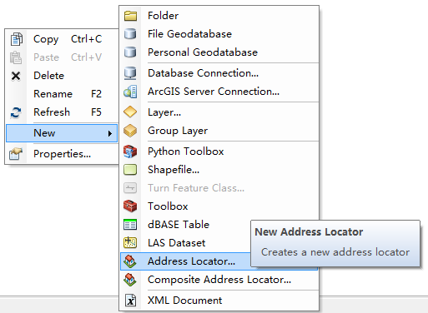
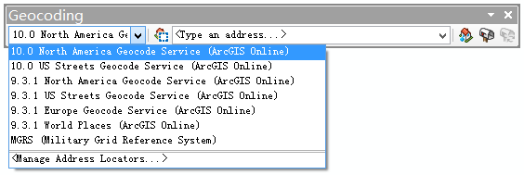
From ArcToolbox to ArcObjects
Usually, we create locators in ArcCatalog. Then we can use geocoding features in the Geocoding toolbar in ArcMap.
(ESRI Locators here)

Slide 6
From ArcToolbox to ArcObjects
Programmatically, We use:
- ILocatorManager
- ILocatorWorkspace
- ILocatorStyle
- ...
Workflow:
Data Collection and Vectorization
Create Address Locator
Wrap Locator Operations in Add-in

Slide 7
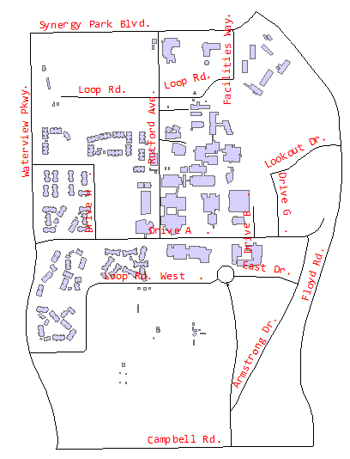
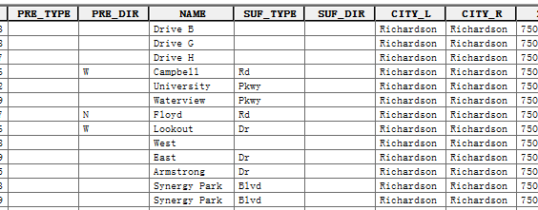
Collecting Data
Reference Data: UTD Campus Map
Data from:
City of Richardson Website
https://www.cor.net

Slide 8
Collecting Data: Issues
Data is incomplete or incorrect:
- Some of the roads will not present
- The direction of road may be wrong
- The fields does not meet the needs to create locators
Solve: Edit the data manually
Some on-campus roads does not have street numbers:
- e.g. Drive A, Armstrong Drive, Loop Road
Solve: Artificially specify street numbers for them.

Slide 9
Creating Locator
1. Create locator manager, open locator workspace, and prepare the reference data (open corresponding shapefile)
' Create the locator manager
Dim pObj As System.Object = Activator.CreateInstance(Type.GetTypeFromProgID("esriLocation.LocatorManager"))
Dim pLocatorManager As ILocatorManager2 = TryCast(pObj, ILocatorManager2)
' Open the default local locator workspace (empty string) to get the locator style.
pLocatorWorkspace = pLocatorManager.GetLocatorWorkspaceFromPath("")
Dim pLocatorStyle As ILocatorStyle = pLocatorWorkspace.GetLocatorStyle("US Address - Dual Ranges")
' Open the utd_road.shp feature class to use as reference data.
Dim pWorkspaceFactory As IWorkspaceFactory = New ShapefileWorkspaceFactory
Dim pFeatureWorkspace As IFeatureWorkspace = pWorkspaceFactory.OpenFromFile(pFolderBrowserDialog.SelectedPath, 0)
Dim pUTDFeatureClass As IFeatureClass
Try
pUTDFeatureClass = pFeatureWorkspace.OpenFeatureClass("utd_road")
Catch ex2 As Exception
Windows.Forms.MessageBox.Show(
"Cannot found required reference data (must be named as utd_road) in the selected folder.", "Error")
Exit Sub
End Try

Slide 10
Creating Locator
2. Edit reference data’s maping fields
' Set the feature class as the primary reference data table for the locator then set the table fields
Do While pReferenceDataFieldEdit IsNot Nothing
Select Case pReferenceDataFieldEdit.InternalName
Case "Primary.PreType"
pReferenceDataFieldEdit.Name_2 = "PRE_TYPE"
Case "Primary.PreDir"
pReferenceDataFieldEdit.Name_2 = "PRE_DIR"
Case "Primary.StreetName"
pReferenceDataFieldEdit.Name_2 = "NAME"
' ......
End Select
pReferenceDataFieldEdit = pEnumReferenceDataField.Next()
Loop
Dim pReferenceDataTableEdit As IReferenceDataTableEdit = CType(pReferenceDataTable, IReferenceDataTableEdit)
Dim pName As IName = pUTDDataset.FullName
pReferenceDataTableEdit.Name_2 = CType(pName, ITableName)

Slide 11
Creating Locator
3. If the reference data is ready, create the locator and save it to the workspace
' Store the new locator in the same workspace as the reference data.
' Use HasEnoughInfo property to determine if the reference data is ready
If pReferenceDataTables.HasEnoughInfo Then
pLocatorWorkspace = pLocatorManager.GetLocatorWorkspaceFromPath(pFolderBrowserDialog.SelectedPath)
pLocator = pLocatorWorkspace.AddLocator("UTD Locator", CType(pLocatorStyle, ILocator), "", Nothing)
Windows.Forms.MessageBox.Show("UTD Locator created at:" & vbCrLf & pFolderBrowserDialog.SelectedPath, "Info")
isGonnaLoadLocator = True
Else
Windows.Forms.MessageBox.Show("Reference data is not enough. Locator creating failed.", "Error")
End If
Finally we got a customed locator.

Slide 12
Creating Locator: Issues
Data exchange among add-in components:
- In some situations, components need to share data.
e.g.
Geocoding could be executed only if the locator has been loaded to program. The status of locator (whether loaded or not) could be a shared data.

Slide 13
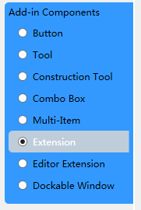
Creating Locator: Issues
Solve 1:
Use the component Extension. It is designed to achieve inter-component communications.
' Store the new locator in the same workspace as the reference data
' Use HasEnoughInfo property to determine if the reference data is ready
Private Shared extUTDLocator As ExtUTDLocatorData
Public WorkspacePath As String = Nothing
Public Locator As ILocator = Nothing
Public Sub New()
extUTDLocator = Me
End Sub
Friend Shared Function GetExtension() As ExtUTDLocatorData
If extUTDLocator Is Nothing Then
Dim extID As UID = New UIDClass()
extID.Value = My.ThisAddIn.IDs.ExtUTDLocatorData
My.ArcMap.Application.FindExtensionByCLSID(extID)
End If
Return extUTDLocator
End Function

Slide 14
Creating Locator: Issues
Public Class ExtUTDLocatorData
Inherits ESRI.ArcGIS.Desktop.AddIns.Extension
' Reference of the extension itself
Private Shared extUTDLocator As ExtUTDLocatorData
' Shared data among components
Public WorkspacePath As String = Nothing
Public Locator As ILocator = Nothing
' Initialize
Public Sub New()
extUTDLocator = Me
End Sub
' Other components can call this function to get access to shared data within this extension class
Friend Shared Function GetExtension() As ExtUTDLocatorData
If extUTDLocator Is Nothing Then
Dim extID As UID = New UIDClass()
extID.Value = My.ThisAddIn.IDs.ExtUTDLocatorData
My.ArcMap.Application.FindExtensionByCLSID(extID)
End If
Return extUTDLocator
End Function
End Class

Slide 15
Creating Locator: Issues
Solve 2:
Directly get the reference of other component using FromID() method
Imports ESRI.ArcGIS.Desktop.AddIns
' Get the reference data of a combo box using its ID
' A component’s ID could be achieved from Config.esriaddinx, or just use ThisAddIn.IDs property like below
Dim cmbStatus As CmbLocatorStatus = AddIn.FromID(Of CmbLocatorStatus)(My.ThisAddIn.IDs.CmbLocatorStatus)
' Then the combo box could be operated
cmbStatus.ChangeStatus(cmbStatus.intEnabled)
Reference for this issue:
http://resources.arcgis.com/en/help/arcobjects-net/conceptualHelp/index.html#//0001000000zz000000

Slide 16
Creating Locator: Issues
Solve Method 2
Add-in
Button 1
Button 2
Combo box
Extension
Solve Method 1
ArcMap Document

Slide 17

Wrap into Add-in
From left to right:
- Status Bar made from an ineditable combo box
* Indicate that if the locator is loaded or not
- Open or Create Locator button
- Geocode Single button
- Reverse Geocode Single tool
- Geocode Table button
- Clear Markers button

Slide 18
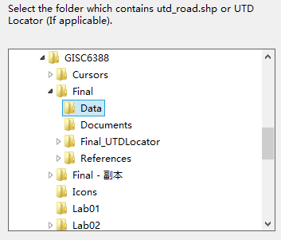
Wrap into Add-in
Open Or Create Locator
Users need to navigate to where the locator has been created, or navigate to the location where the reference data (in this case hardcoded as utd_road.shp) presents.
The Status Bar would turn to “Enabled” once the locator loaded

Slide 19
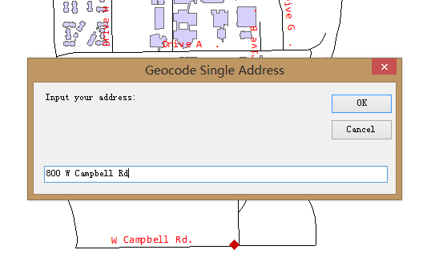
Wrap into Add-in
Geocode Single
Users could input a single address to be geocoded. The result would be shown as a marker on the map.

Slide 20
Wrap into Add-in
Geocode Single: Implementation
' Set input address properties
' All hardcoded (UTD is completely in Richardson, TX 75080) except the detailed address
Dim pAddressProperties As IPropertySet = New PropertySet
With pAddressProperties
.SetProperty("Street", Address)
.SetProperty("City", "Richardson")
.SetProperty("State", "TX")
.SetProperty("ZIP", "75080")
End With
' Do geocoding
Dim pMatchProperties As IPropertySet = AddressGeocodingLocator.MatchAddress(pAddressProperties)
' Show result and add marker to map
……

Slide 21
Wrap into Add-in
Reverse Geocode Single
Allow user to click on the map to get the corresponding address.

Slide 22
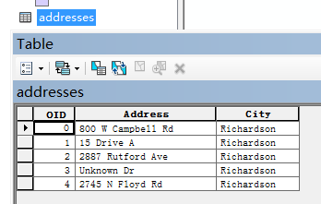
Wrap into Add-in
Geocode Table
Geocode a table of addresses. The result can be shown on the map as multiple markers, or saved as a point feature class.
Invalid data would not be geocoded.

Slide 23
Wrap into Add-in
Clear Markers
Simply clear all the markers on the map.
Just do this if you love to be clean :)

Slide 24
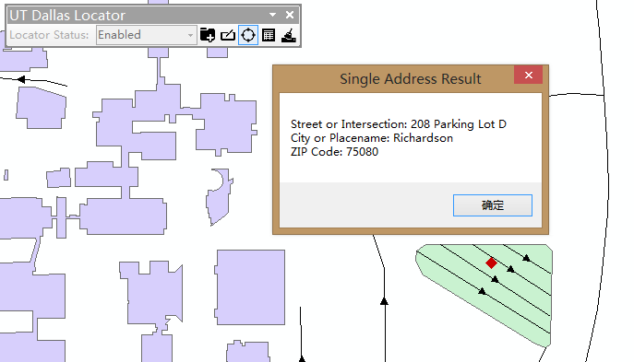
What’s more?
This system could be extended. Reference data could be updated, and we may just rebuild the locator.
Just create “road” feature for parking lots. Then rebuild locator, and you can use this to locate your car.
You only need to remember the “street number” in your parking lot name (e.g. Parking Lot D) on campus.

Slide 25
Thank you!
Caiyi Zhong
Apr. 28th, 2014

